Slide 1
ECE 721 Project 4
Team 09
Viren Sanjay Mehra
Avit Ramakant Rane

Slide 2
Contents
Immediate Recovery on Value Misprediction (VR-5)
Enhanced SVP
SVP indexed with Branch History
Experiments

Slide 3
Immediate Recovery on Value Misprediction (VR-5) - Proposition
Do not wait till the mispredicted instruction reaches the head of the Active List, start recovery immediately after mispredict is detected
Could improve IPC because time to resolve mispredicted instruction is lesser
Tradeoff – GBM has to be shared by branches and value predictions, which puts extra strain on the GBM

Slide 4
Immediate Recovery on Value Misprediction (VR-5) - Implementation
In Fetch stage - checkpoint the branch queue tail and tailphase for instructions that are not a branch.
In Rename stage - check if GBM has enough bits for both branches and value prediction eligible instructions, if yes create those checkpoints
In Execute stage - if value is correctly predicted, clear its GBM bit using the resolve functions of renamer and pipeline. In case of a misprediction repair the LSQ, VPQ ,branch queue and pipeline like we did in branches but we don’t need to push the instruction back into the branch queue again. We just roll back to the checkpointed tail and BHR value.

Slide 5
Enhanced SVP Proposition
Introduce Probabilistic counters (Morris Counters) to have the effect of a larger counter using fewer bits
Different probabilities for different instruction types – since cost vs. benefit of value prediction might be different for different instructions
Add an age counter to enable replacing of stale entries. There could be instructions in the SVP have high confidence but are not referenced by the program anymore, so we would have a tag miss and new instructions will not replace this entry.

Slide 6
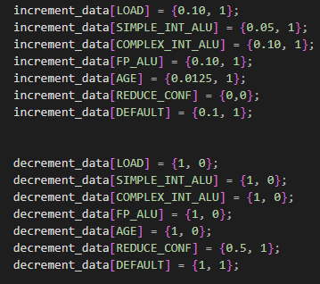
Enhanced SVP Implementation
We model a 16-bit lfsr using a C++ random number generator in which generates a value between 0 and 65535
Use a map to assign different probabilities of increment and decrement for different instructions
In hardware – each entry would also be 16-bit
Eg. For Load increment –
Threshold = floor(0.1*65535) = 6553
If LFSR generates a value < Threshold
Counter = counter + increment

Slide 7
SVP indexed with Branch History- Proposition
Expands the Enhanced SVP – the current SVP has a lot of unused entries
Adding more context (using branch history) to our SVP table – inspired by gshare
We would have specialized entries for a given PC, for different branch contexts

Slide 8
SVP indexed with Branch History- Implementation
We add the most updated BHR to the payload of an instruction in the Fetch stage
Index into the SVP table by xor’ing the BHR bits from the payload and the lowest significant bits of the PC
To fit a larger table with 11 index bits in the given budget, convert stride to a 32 bit variable

Slide 9
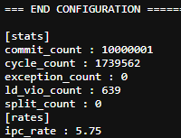
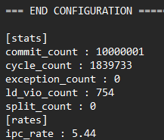
Experiments – VR5
make cleanrun SIM_FLAGS_EXTRA='--vp-enable=1 --vp-svp=300,0,10,10,15,1,0,15,15,1,0,0,0 --mdp=3,31 --perf=0,0,0,1 -t --cbpALG=0 --fq=64 --cp=32 --al=256 --lsq=128 --iq=64 --iqnp=4 --fw=8 --dw=8 --iw=16 --rw=8 -e10000000’
VR-1 VR-5

Slide 10
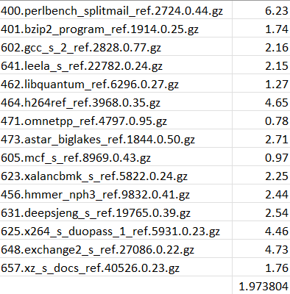
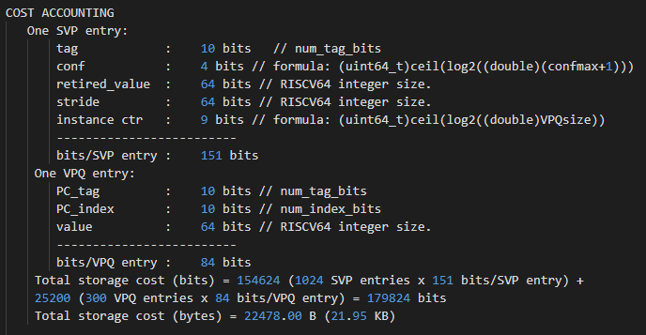
Experiments – Base SVP
--vp-enable=1 --vp-svp=300,0,10,10,15,1,0,15,15,1,1,1,0 --mdp=3,31 --perf=0,0,0,1 -t --cbpALG=0 --fq=64 --cp=32 --al=256 --lsq=128 --iq=64 --iqnp=4 --fw=8 --dw=8 --iw=16 --rw=8 -e10000000"

Slide 11
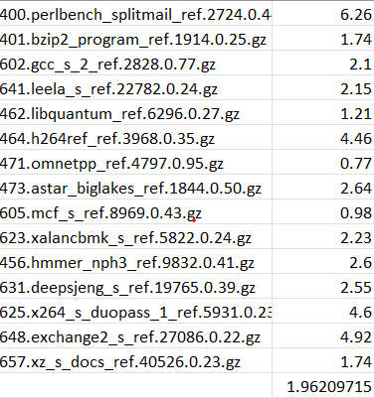
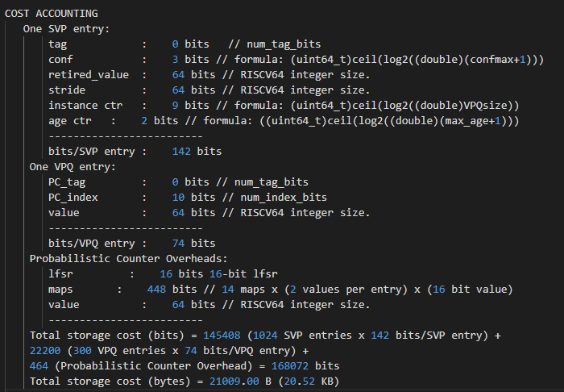
Experiments – Enhanced SVP
--vp-enable=1 --vp-esvp=300,0,10,0,7,1,0,7,7,1,1,1,0,3 --mdp=3,31 --perf=0,0,0,1 -t --cbpALG=0 --fq=64 --cp=32 --al=256 --lsq=128 --iq=64 --iqnp=4 --fw=8 --dw=8 --iw=16 --rw=8 -e10000000"

Slide 12
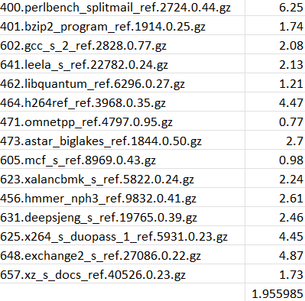
Experiments – Enhanced SVP
--vp-enable=1 --vp-esvp=300,0,10,0,7,1,0,7,7,1,1,1,0,3 --mdp=3,31 --perf=0,0,0,1 -t --cbpALG=0 --fq=64 --cp=32 --al=256 --lsq=128 --iq=64 --iqnp=4 --fw=8 --dw=8 --iw=16 --rw=8 -e10000000“
Predicting simple ALU Instructions more addressively compared to previous slide

Slide 13
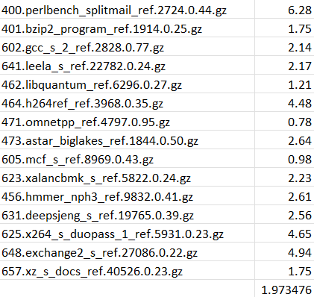
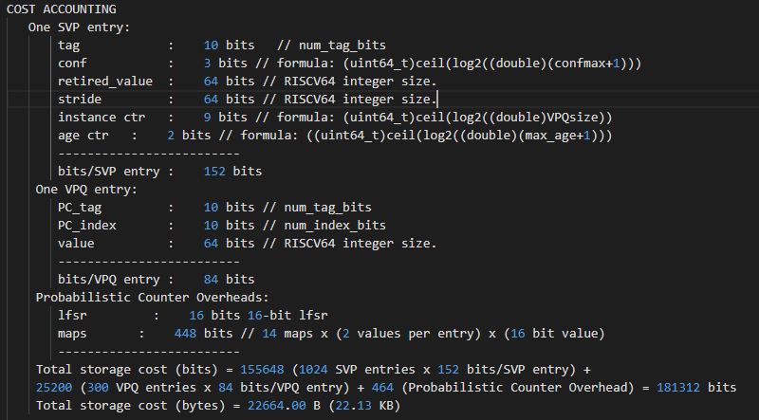
Experiments – Enhanced SVP
--vp-enable=1 --vp-esvp=300,0,10,10,7,1,0,7,7,1,1,1,0,3 --mdp=3,31 --perf=0,0,0,1 -t --cbpALG=0 --fq=64 --cp=32 --al=256 --lsq=128 --iq=64 --iqnp=4 --fw=8 --dw=8 --iw=16 --rw=8 -e10000000

Slide 14
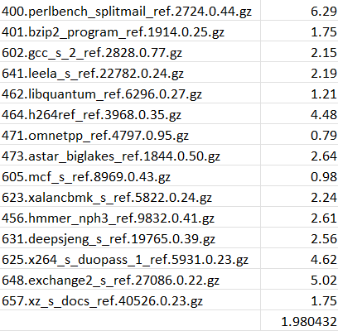
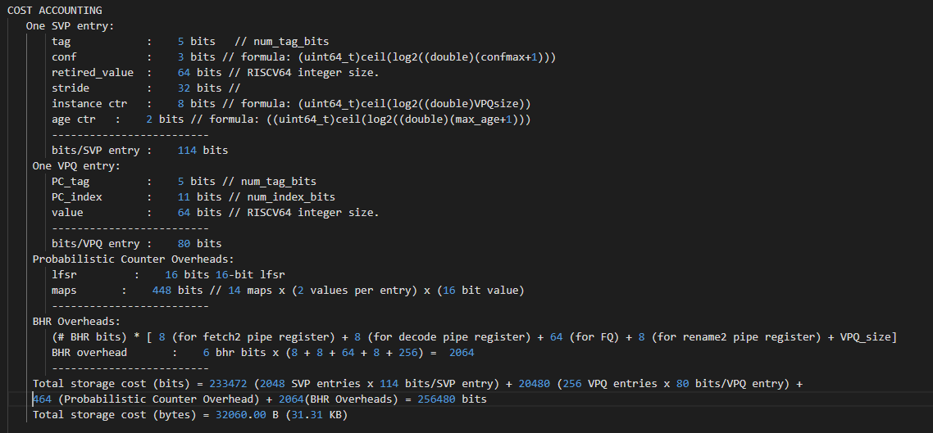
Experiments – E-SVP with Branch History
--vp-enable=1 --vp-esvp-bhr=256,0,11,5,7,1,0,7,7,1,1,1,0,3,6 --mdp=3,31 --perf=0,0,0,1 -t --cbpALG=0 --fq=64 --cp=32 --al=256 --lsq=128 --iq=64 --iqnp=4 --fw=8 --dw=8 --iw=16 --rw=8 -e10000000“
Used 6 BHR bits for indexing

Slide 15
Thank you

